Slide 1
Graphics And PHP

Slide 2
The Web is more than just text.
Images appear in the form of logos, buttons, photographs, charts, advertisements, and icons.
Many of these images are static and never change, built with tools such as Photoshop.
Some are dynamically created—graphs of stock performance.
Graphics in PHP typically involve creating, manipulating, and rendering images and visual content.
PHP supports graphics creation with the built-in GD (Graphics Draw) extension
GD allows you to create and manipulate images, draw shapes, add text, and perform various image processing tasks.
GD supports image formats in jpeg, png, gif, and wbmp.

Slide 3
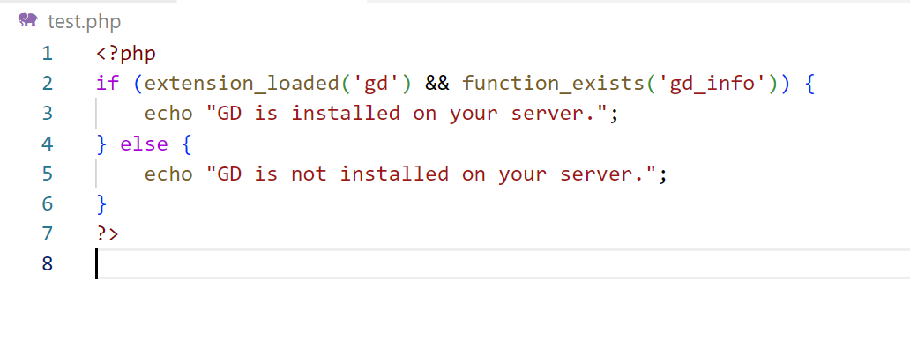
How to check if GD is installed or not

Slide 4


If GD is not installed, you may need to enable it in your PHP configuration.
Open files C:\xampp\php

Slide 5
Open PHP Config file
Search For GD
Enable GD extension by removing the semicolon from the front
Restart your Xampp Server and now your GD library is installed on the system.

Slide 6
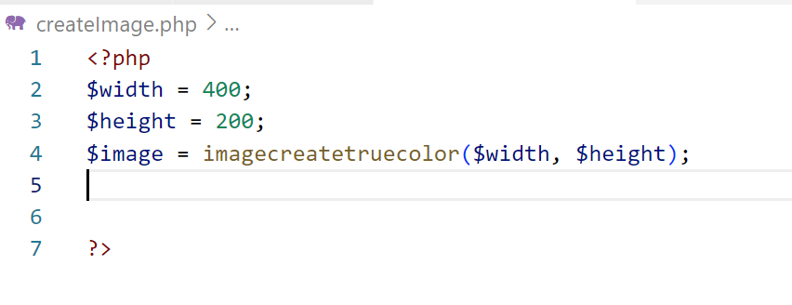
Creating an Image:
You can create a new image using the imagecreate() or imagecreatetruecolor function, which creates a true-color image resource.
imagecreatetruecolor() returns an image object representing a black image of the specified size.

Slide 7

Drawing on the Image:
The imagecolorallocate() function can be used to create the link, and it requires four arguments

Slide 8
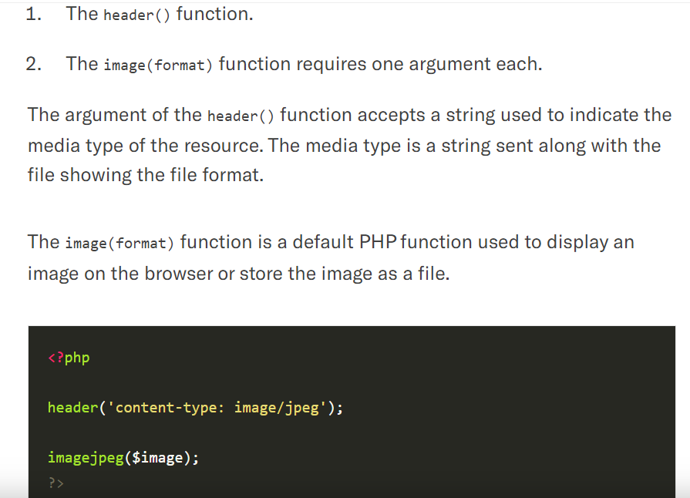

Slide 9
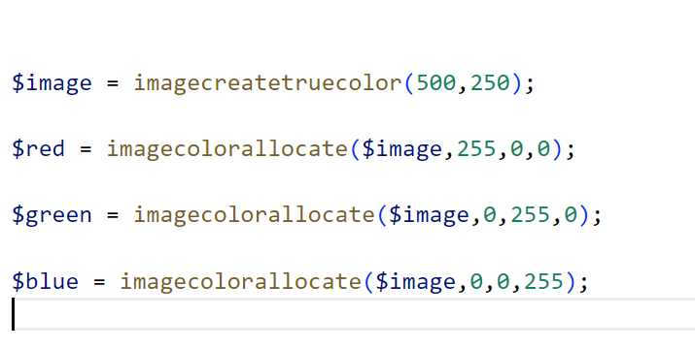
Working example

Slide 10
<?php
$values = array(
150, 50, // Point 1 (x, y)
50, 250, // Point 2 (x, y)
250, 250 // Point 3 (x, y)
);
$image = imagecreatetruecolor(300, 300);
$background_color = imagecolorallocate($image, 0, 153, 0);
imagefill($image, 0, 0, $background_color);
$image_color = imagecolorallocate($image, 255, 255, 255);
imagepolygon($image, $values, 3, $image_color);
header('Content-type: image/png');
imagepng($image);
?>

Slide 11
<?php
header ('Content-Type: image/png');
$im = imagecreatetruecolor(120, 20);
$text_color = imagecolorallocate($im, 233, 14, 91);
imagestring($im, 1, 5, 5, 'A Simple Text String', $text_color);
imagepng($im);
imagedestroy($im);
?>
imagestring( GdImage $image, GdFont|int $font, int $x, int $y, string $string, int $color ): bool

Slide 12
Basic Drawing Functions
imagesetpixel(image, x, y, color)
Imagesetpixel( ) sets the color of a specified pixel.
Functions for drawing lines
imageline(image, start_x, start_ y, end_x, end_ y, color);
imagedashedline(image, start_x, start_ y, end_x, end_ y, color);
Functions for drawing rectangles
imagerectangle(image, tlx, tly, brx, bry, color);
imagefilledrectangle(image, tlx, tly, brx, bry, color);
Functions for drawing polygons
imagepolygon(image, points, number, color);
imagefilledpolygon(image, points, number, color);

Slide 13
Basic Drawing Functions
<?php
//how to create our first image
$image = imagecreate(500,250);
//Allocate colors to the image
$red = imagecolorallocate($image,255,0,0);
$green = imagecolorallocate($image,0,255,0);
$blue = imagecolorallocate($image,0,0,255);
Imagefill($image,0,0,$blue);
//display the image
header('content-type: image/jpeg');
imagejpeg($image);
?>

Slide 14

Basic Drawing Functions

Slide 15
Rectangle
<?php
$image = imagecreate(200, 200);
$bgcolor = imagecolorallocate($image, 0, 0, 255);
$fgcolor = imagecolorallocate($image, 255, 0, 0);
imagefilledrectangle($image, 100, 50, 150, 150, $fgcolor);
header("Content-Type: image/jpeg");
imagejpeg($image);
?>

Slide 16

OUTPUT

Slide 17
<?php
$data = [30, 50, 70, 90];
$maxValue = max($data);
$width = 400;
$height = 200;
$barWidth = $width / count($data);
$image = imagecreatetruecolor($width, $height);
$bgColor = imagecolorallocate($image, 255, 255, 255);
$barColor = imagecolorallocate($image, 0, 0, 255);
imagefill($image, 0, 0, $bgColor);
foreach ($data as $key => $value) {
$x1 = $key * $barWidth;
$x2 = ($key + 1) * $barWidth - 1;
$y1 = $height - ($value / $maxValue * $height);
$y2 = $height - 1;
imagefilledrectangle($image, $x1, $y1, $x2, $y2, $barColor);
}
header("Content-type: image/png");
imagepng($image);
imagedestroy($image);
?>

Slide 18
imagefill($image, 0, 0, $bgColor);
imageline($image, $margin, $margin, $margin, $height - $margin, $axisColor);
imageline($image, $margin, $height - $margin, $width - $margin, $height - $margin, $axisColor);
for ($i = 0; $i < $xMax; $i++) {
$x = $margin + ($i - $xMin) * $stepX;
$y = $height - $margin - ($data[$i] - $yMin) * $stepY;
if ($i > 0) {
imageline($image, $x - $stepX, $yPrev, $x, $y, $lineColor);
}
$yPrev = $y;
}
header("Content-type: image/png");
imagepng($image);
imagedestroy($image);
?>
<?php
$data = [10, 20, 15, 25, 30, 40];
$width = 400;
$height = 200;
$margin = 30;
$yMax = max($data);
$yMin = 0;
$xMax = count($data);
$xMin = 1;
$stepX = ($width - 2 * $margin) / ($xMax - $xMin);
$stepY = ($height - 2 * $margin) / ($yMax - $yMin);
$image = imagecreatetruecolor($width, $height);
$bgColor = imagecolorallocate($image, 255, 255, 255);
$axisColor = imagecolorallocate($image, 0, 0, 0);
$lineColor = imagecolorallocate($image, 0, 0, 255);

Slide 19
Image manipulation
Image processing and GD functions are used to create and manipulate image files in different image formats including GIF, PNG, JPEG, WBMP, and XPM. PHP can deliver the output image directly to the browser.
The image processing and GD functions are used to compile the image functions for this work. It can also require other libraries, depending on the image formats.

Slide 20
function
getimagesize() Get the size of an image.
bool imagearc( $image, $cx, $cy, $width, $height, $start, $end, $color )
imagechar()
The imagechar() function is an inbuilt function in PHP which is used to draw a character horizontally.
This function draws the first character of string in the image identified by image with its x and y-axis.
Syntax:
bool imagechar( $image, $font, $x, $y, $c, $color )
imagecharup() function is an inbuilt function in PHP which is used to draw a character vertically.
imagecrop() function is an inbuilt function in PHP which is used to crop an image to the given rectangle.

Slide 21
IMAGE CREATE FUNCTIONS
Image Creation and Initialization
imagecreatetruecolor(): Create a new true-color image.
imagecreatefromjpeg(), imagecreatefrompng(), imagecreatefromgif(): Create an image resource from existing image files (JPEG, PNG, GIF).
imagecreatefromstring(): Create an image resource from a string.

Slide 22
Imagerotate
<?php
// File and rotation
$filename = 'test.jpg';
$degrees = 45;
// Content type
header('Content-type: image/jpeg');
// Load
$source = imagecreatefromjpeg($filename);
// Rotate
$rotate = imagerotate($source, $degrees, 0);
// Output
imagejpeg($rotate);
// Free the memory
imagedestroy($source);
imagedestroy($rotate);
?>

Slide 23
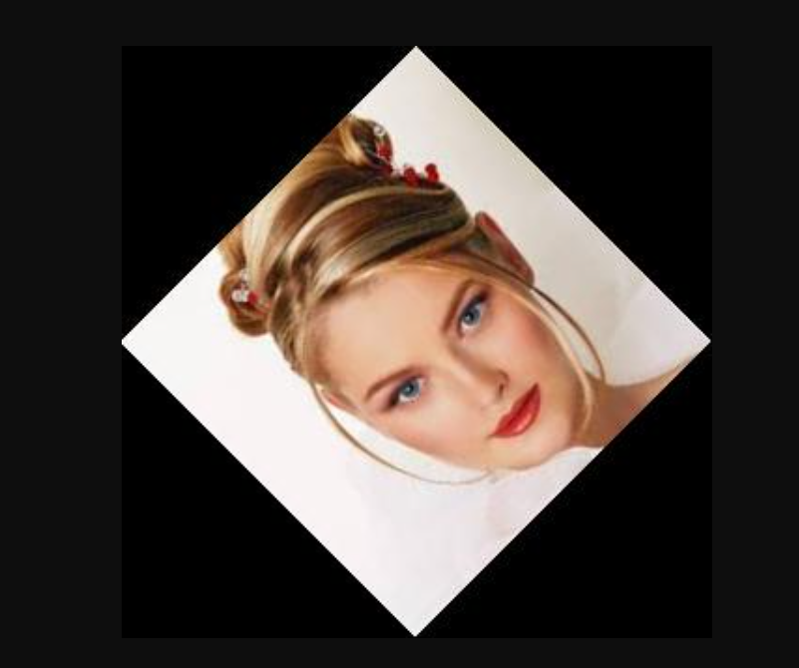
OUTPUT

Slide 24
Drawing Basic Shapes
imageline(): Draw a line.
imagerectangle(): Draw a rectangle.
imagefilledrectangle(): Draw and fill a rectangle.
imageellipse(): Draw an ellipse.
imagefilledellipse(): Draw and fill an ellipse.
imagearc(): Draw an arc.

Slide 25
Drawing Complex Shapes:
imagepolygon(): Draw a polygon.
imagefilledpolygon(): Draw and fill a polygon.
imagecreatepolygon(): Create a new polygon.
Drawing Text:
imagettftext(): Draw TrueType text on an image.
imagestring(): Draw a string horizontally.
imagestringup(): Draw a string vertically.

Slide 26
Image Manipulation:
imagecopyresized(): Copy and resize part of an image.
imagecopyresampled(): Copy and resample part of an image.
imagecrop(): Crop an image to the given rectangle.
imagerotate(): Rotate an image.
Image Filters:
imagefilter(): Apply a filter to an image (e.g., blur, grayscale, contrast).

Slide 27
Image Output:
imagepng(): Output the image as a PNG file.
imagejpeg(): Output the image as a JPEG file.
imagegif(): Output the image as a GIF file.
imagewbmp(): Output the image as a WBMP file.
Resource Cleanup:
imagedestroy(): Deallocate the image resource to free memory.

Slide 28
IMAGES WITH TEXT

Slide 29
Imagecreate(height,width)
imagefilledrectangle ( resource $image , int $x1 , int $y1 , int $x2 , int $y2 , int $color )
x1: x coordinate for point 1, y1: y coordinate for point 1.
x2: x coordinate for point 2, y2: y coordinate for point 2.
imagettftext ( resource $image , $size , $angle , $x , $y , $color , $fontfile , $text ).

Slide 30
Imagecreate(height,width)
imagefilledrectangle ( resource $image , int $x1 , int $y1 , int $x2 , int $y2 , int $color )
x1: x coordinate for point 1, y1: y coordinate for point 1.
x2: x coordinate for point 2, y2: y coordinate for point 2.
imagettftext ( resource $image , $size , $angle , $x , $y , $color , $fontfile , $text ).
The angle in degrees, with 0 degrees being left-to-right reading text. Higher values represent a counter-clockwise rotation. For example, a value of 90 would result in bottom-to-top reading text.

Slide 31
<?php $image = imagecreate(200, 200); $white = imagecolorallocate($image, 0xFF, 0xFF, 0xFF); $black = imagecolorallocate($image, 0x00, 0x00, 0x00); imagefilledrectangle($image, 50, 50, 150, 150, $black); imagestring($image, 5, 50, 160, "A Black Box", $black); header("Content-Type: image/png"); imagepng($image);

Slide 32
Example : Adding text to an image
<?php $image = imagecreate(350, 70); $white = imagecolorallocate($image, 0xFF, 0xFF, 0xFF); $black = imagecolorallocate($image, 0x00, 0x00, 0x00); // set the path for GD to look for TrueType paths putenv("GDFONTPATH=" . realpath('.')); imagettftext($image, 20, 0, 10, 40, $black, 'courbi', "Courier TrueType"); header("Content-Type: image/png"); imagepng($image);

Slide 33
<?php
$im = ImageCreate(300,300);
$black= ImageColorallocate($im,255,255,120);
$red = ImageColorAllocate($im,255,0,0);
ImageString($im,5,50,160,"hello how are you",$red);
Header('Content-Type: image/png');
ImagePNG($im);
?>

Slide 34
Create a new PHP script for drawing an arc:
<?php
// Create a blank image with a white background
$width = 400;
$height = 400;
$image = imagecreatetruecolor($width, $height);
$bgColor = imagecolorallocate($image, 255, 255, 255);
imagefill($image, 0, 0, $bgColor);
// Define the arc color (e.g., red)
$arcColor = imagecolorallocate($image, 255, 0, 0);
// Draw an arc
$startAngle = 45; // Starting angle in degrees
$endAngle = 135; // Ending angle in degrees
$x = $width / 2; // X-coordinate of the arc's center
$y = $height / 2; // Y-coordinate of the arc's center
$radiusX = 150; // X-axis radius
$radiusY = 100; // Y-axis radius
imagearc($image, $x, $y, $radiusX, $radiusY, $startAngle, $endAngle, $arcColor);
// Output the image to the browser
header("Content-type: image/png");
imagepng($image);
// Clean up resources
imagedestroy($image);
?>

Slide 35
To create a polygon in graphics using PHP
<?php
// Create a blank image
$width = 400;
$height = 400;
$image = imagecreatetruecolor($width, $height);
// Define colors
$white = imagecolorallocate($image, 255, 255, 255);
$red = imagecolorallocate($image, 255, 0, 0);
// Fill the background with white
imagefill($image, 0, 0, $white);
// Define polygon points
$points = array(
200, 50, // Point 1 (x, y)
250, 100, // Point 2
300, 100, // Point 3
350, 50, // Point 4
300, 0 // Point 5
);
// Draw the polygon
imagepolygon($image, $points, count($points) / 2, $red);
// Output the image to the browser
header("Content-type: image/png");
imagepng($image);
// Clean up resources
imagedestroy($image);
?>

Slide 36
To create an ellipse in graphics using PHP
<?php
// Create a blank image
$width = 400;
$height = 400;
$image = imagecreatetruecolor($width, $height);
// Define colors
$white = imagecolorallocate($image, 255, 255, 255);
$blue = imagecolorallocate($image, 0, 0, 255);
// Fill the background with white
imagefill($image, 0, 0, $white);
// Define ellipse properties
$x = $width / 2; // X-coordinate of the ellipse's center
$y = $height / 2; // Y-coordinate of the ellipse's center
$widthEllipse = 200; // Width of the ellipse
$heightEllipse = 100; // Height of the ellipse
// Draw the ellipse
imageellipse($image, $x, $y, $widthEllipse, $heightEllipse, $blue);
// Output the image to the browser
header("Content-type: image/png");
imagepng($image);
// Clean up resources
imagedestroy($image);
?>

Slide 37
Scaling Images
There are two ways to change the size of an image.
The imagecopyresized() function is fast but crude, and may lead to jagged edges in your new images.
The imagecopyresampled() function is slower, but features pixel interpolation to give smooth edges and clarity to the resized image.
Both functions take the same arguments: imagecopyresized(dest, src, dx, dy, sx, sy, dw, dh, sw, sh); imagecopyresampled(dest, src, dx, dy, sx, sy, dw, dh, sw, sh);

Slide 38
<?php $source = imagecreatefromjpeg("php.jpg"); $width = imagesx($source); $height = imagesy($source); $x = $width / 2; $y = $height / 2; $destination = imagecreatetruecolor($x, $y); imagecopyresampled($destination, $source, 0, 0, 0, 0, $x, $y, $width, $height); header("Content-Type: image/png"); imagepng($destination);

